Slide 1
3D Printing ?

Slide 2
index
1. What is 3D printing?
2. Various types of 3D printer filaments
3. Development and change of 3D printer
4. What is 3D printer now?
5. Various types of 3D printer modeling program
6. Can I do it?

Slide 3
1. What is 3D printing?
Definition of 3D printer
computer control
material
3D printing is any of various processes in which material is joined or solidified
under computer control to create a three-dimensional object, with material being
added together

Slide 4
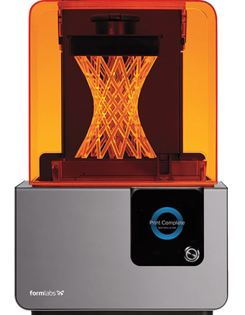
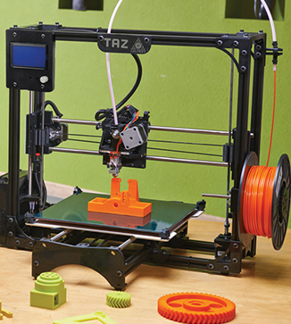
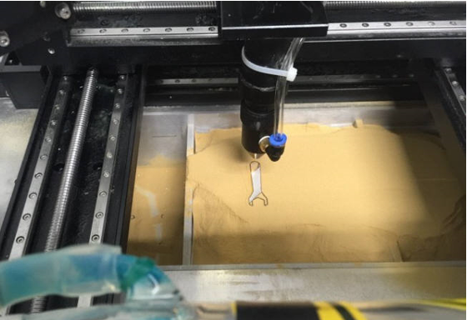
1. What is 3D printing?
Types of 3D printers
FND
SLA
SLS
Three major printers classified by output method

Slide 5
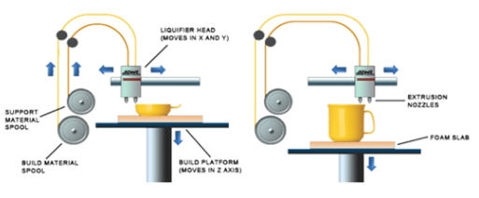
Types of 3D printers
FND : Fused Deposition Modeling
It refers to the method of 3D printing
by melting filament-type thermoplastic material
in nozzle and stacking from bottom to top
Strong in strength,
strong in humidity and durable
Melt -> Stack -> Hard
Solid-based

Slide 6
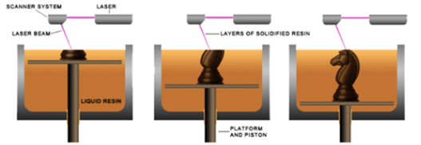
Types of 3D printers
SLA : Stereolithography
The laser is projected and hardened by the laser.
Each time a layer is stacked,
this building platform moves and assigns the next stack.
3D printing is completed by laser-hardening the specified area.
High precision makes surface smooth and precise.
Durability and heat resistance are weak and
production cost is high.
Liquid -> Hard
Liquid-based

Slide 7
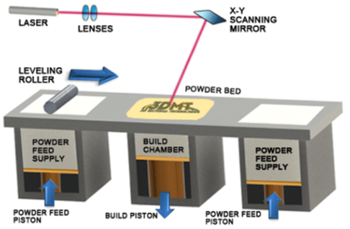
Types of 3D printers
SLS : Selective Laser Sintering
A method of melting powdered plastic, metal, and glass lasers by laser,
solidifying them, and layering them in three dimensions.
The speed is fast and the materials used are very wide,
depending on the size of the powder mass, and
the price is very expensive compared to other methods.
Powder -> Hard
Powder-based

Slide 8
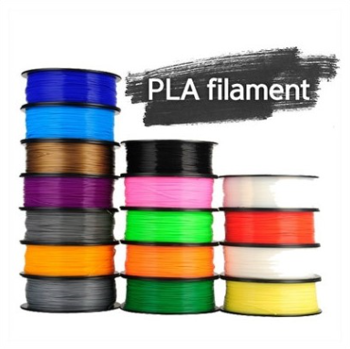
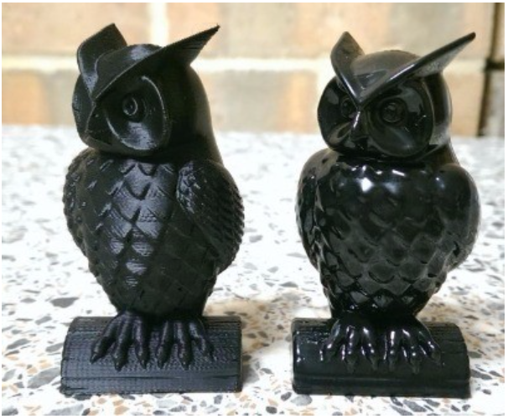
2. Various types of 3D printer filaments
ABS : Acry lonitile, Poly-Butadiene, Styrene
It is the material of plastic products,
and it smells at the output.
Acetone fumigation is possible
using the property of melting in acetone.
PLA : Poly Lactic Acid
Eco-friendly resin made from raw material
extracted from cornstarch, less shrinkage and
can be used without heating bed

Slide 9
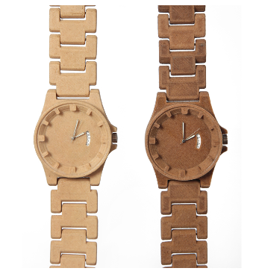
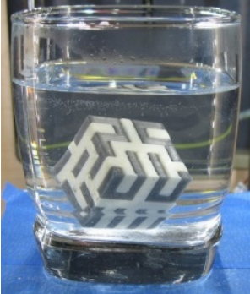
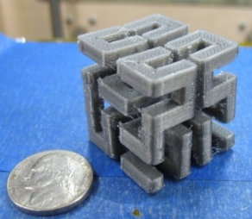
2. Various types of 3D printer filaments
PVA : Poly Vinyl Alcohol
Eco-friendly material that easily dissolves in water.
When used as a support in dual 3D printers,
it melts in water.
WOOD
Filament made by mixing sawdust.
It can be cut and changed like a tree.

Slide 10
3. Development and change of 3D printer
1981 Hideo Kodama, working at the Nagoya Institute of Technology, is the first to introduce
prototypes of 3D printers using photosensitive paper.
1984 The world's first SLA-based 3D printer is born. By Charles Hull in 3D Systems
1991 Stratasys produces the world's first FDM-based printer.
1992 3D Systems is the world's first to produce SLA-style printers.
DTM company also starts to produce SLS type printer.
2002 Scientists have created a small-sized kidneys that prints.
2009 Makerbot has released a 3D printer from Open Source Systems. 3D printers can now be
purchased for as little as $ 750.
2011 Cornell University will begin to develop 3D printer for food.
Kor Ecologic unveils Urbee, a car with bodywork output from a 3D printer.
2014 We built 10 houses of 200 square meters per day using structures extracted from 3D printers in China. built 10 houses of 200 square meters per day using structures extracted from 3D printers in China.

Slide 11
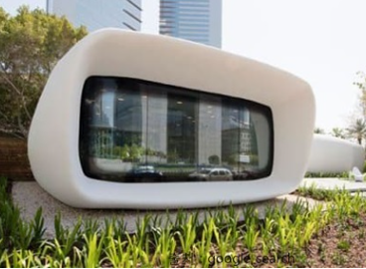
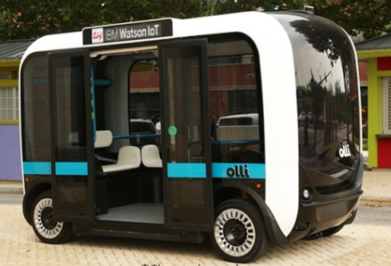
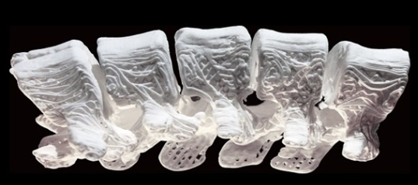
3. What is 3D printer now?
construct
Medical field
Parts production

Slide 12
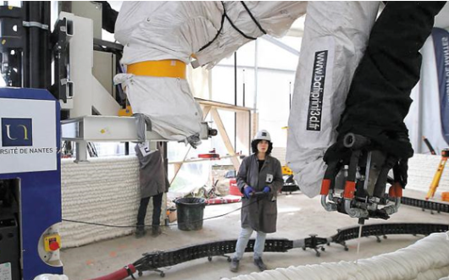
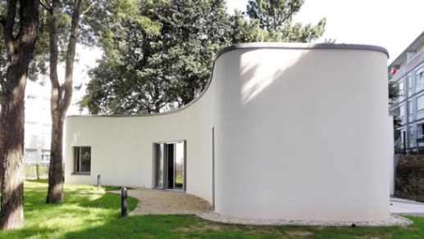
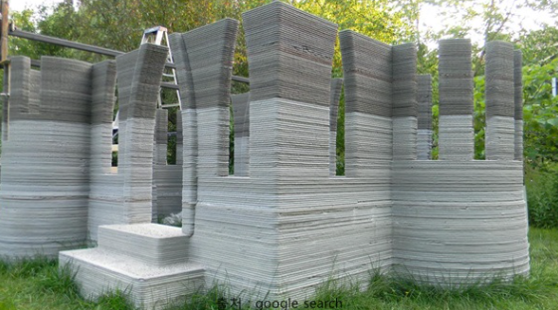
1.construct
In August 2012, Prof. Behrokh Khoshnevis at TedxOjai showed that
it is possible to build a house in 20 hours using a technique called
Contour crafting. While 3D printers have a number of problems,
such as slower, more inefficient, and more dangerous tasks,
3D printers are able to minimize the cost of materials and waste
in less time.
Nantes researchers created a computerized home plan to match
the site provided by the city and then transferred the data to the architectural
3D printer, 'Batty Print 3D'. Batty Print 3D moved the 4-meter robot arm
from the construction site to build up the walls as designed.

Slide 13
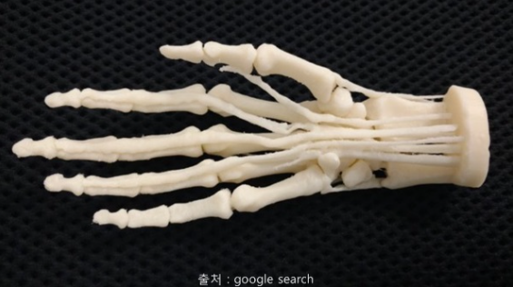
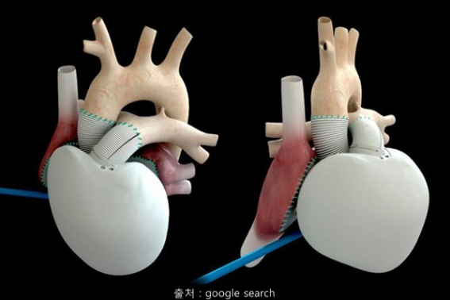
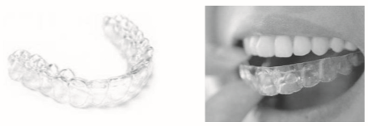
2. Medical field
3D bioprinting technology is evolving one day differently. For the past 2 ~ 3 years,
it has been commercialized mainly for dental and orthopedic biomedical devices
(solid implants) such as customized facial contour implants, under-eye bone surgery
due to orbital fractures, and membranes for separating gums and bones from implants It went on.
Then, 3D printing technology developed, and the living cells `output` to the desired form and cultivating
the supply of nutrients developed. Some companies are challenging even the production of mini-nails
with nails that can be used in clinical trials to create human

Slide 14
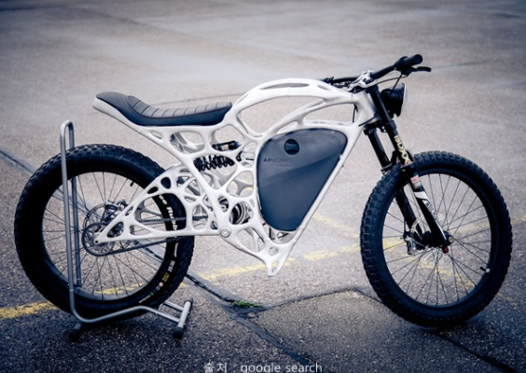
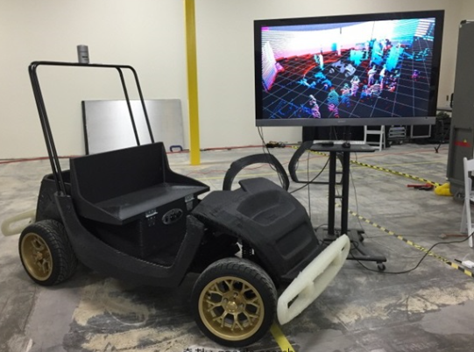
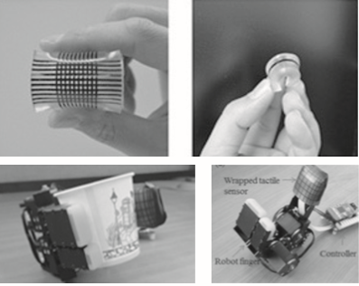
3. Parts production
The biggest advantage of 3D printers is that they can be
produced in a single process, even with complex designs and shapes.
No more molds are needed when making metal products.

Slide 15
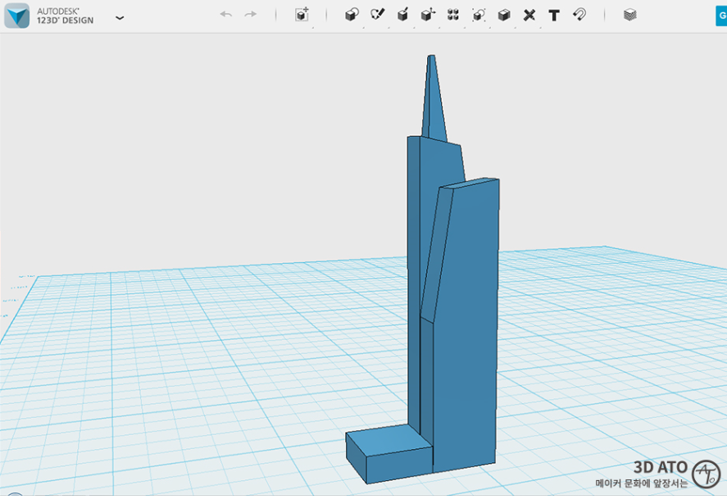
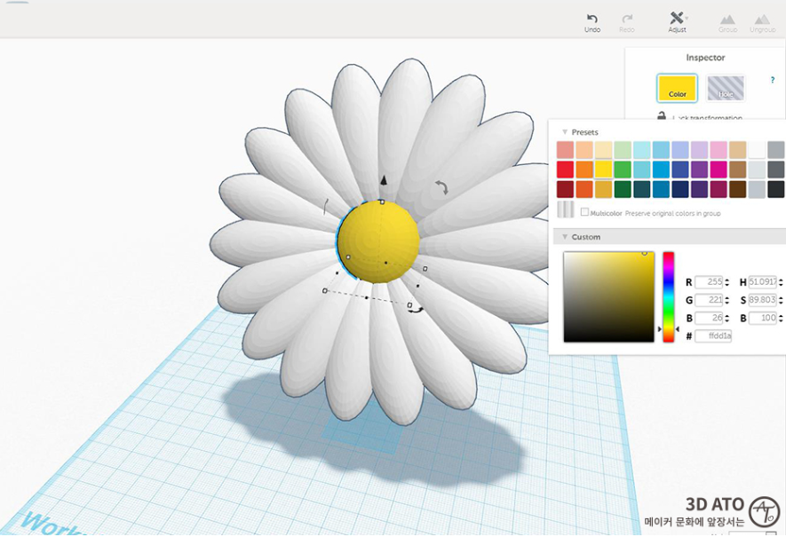
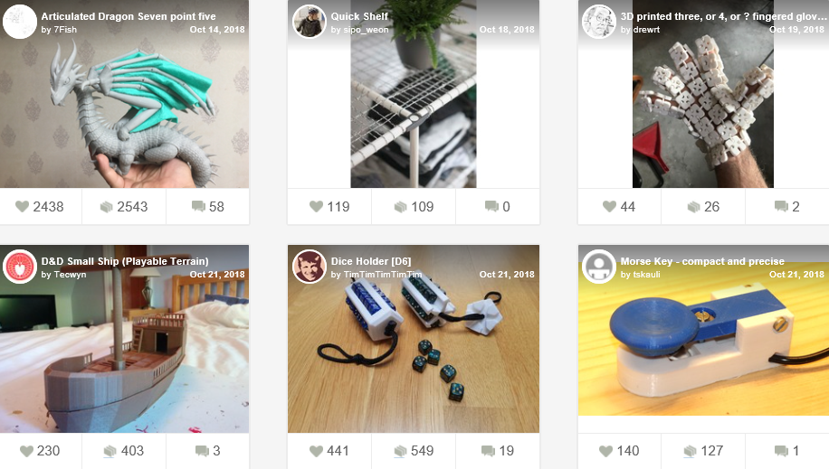
5. Various types of 3D printer modeling program
It can be used immediately without installation online, so it is easy to use
anytime and anywhere. It is easy to create initial shapes or simple shapes using
only a mouse.
In the thingiverse you can see other people's print works or get drawings.
123D DESIGN
tinkercad
thingiverse
123D Design is a program that makes 3D modeling easy and easy.
If you are new to 3D printers, and are new to 3D modeling. It's a free, easy-to-use program

Slide 16


6. Can I do it?
1 hour – 4000won
free

Slide 17
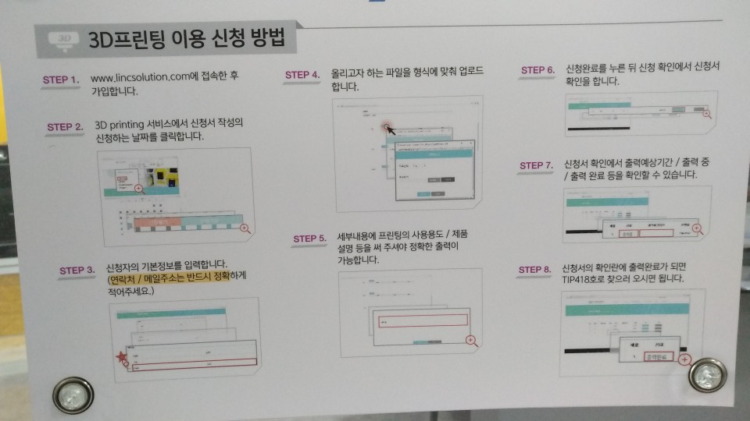
6. Can I do it?

Slide 18
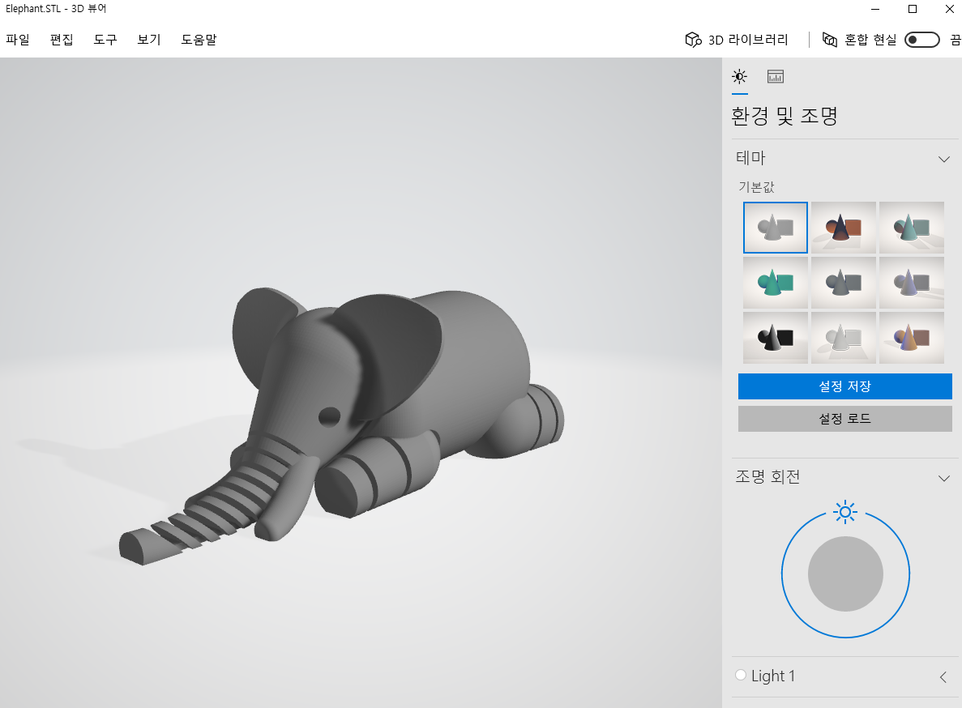
6. Can I do it?

Slide 19
2. Parts production
http://www.chemidream.com/1640
http://3dprinterstore.co.kr/product/폼2-form2/86/
https://m.blog.naver.com/3dmac/220254011713
http://www.etnews.com/20150303000098
https://m.blog.naver.com/PostView.nhn?blogId=te79&logNo=220761885552&proxyReferer=http%3A%2F%2Fwww.google.com%2Furl%3Fsa%3Dt%26rct%3Dj%26q%3D%26esrc%3Ds%26source%3Dweb%26cd%3D3%26ved%3D2ahUKEwjz6rfZ7oPfAhVOat4KHcoxAzUQFjACegQICxAM%26url%3Dhttp%253A%252F%252Fm.blog.naver.com%252Fte79%252F220761885552%26usg%3DAOvVaw2as0HcbDCLSm-vd-IGLoDz
https://rgy0409.tistory.com/1138
http://news.unist.ac.kr/kor/column_67/
https://kocoafab.cc/k_blog/view/459
http://www.elec4.co.kr/article/articleView.asp?idx=6083
https://m.blog.naver.com/PostView.nhn?blogId=zestybox&logNo=220637973448&proxyReferer=http%3A%2F%2Fwww.google.com%2Furl%3Fsa%3Dt%26rct%3Dj%26q%3D%26esrc%3Ds%26source%3Dweb%26cd%3D2%26ved%3D2ahUKEwiy-8Xzz4TfAhUMVLwKHX47BmAQFjABegQICBAB%26url%3Dhttp%253A%252F%252Fm.blog.naver.com%252Fzestybox%252F220637973448%26usg%3DAOvVaw20jtkYlhH2sHQy201Y-NnN
http://it.donga.com/20408/
http://www.itworld.co.kr/t/65209/3D%ED%94%84%EB%A6%B0%ED%8C%85/107090
http://hplogis.co.kr/?page_id=25
https://m.post.naver.com/viewer/postView.nhn?volumeNo=12669750&memberNo=1963961
http://biz.chosun.com/site/data/html_dir/2018/07/12/2018071200024.html
https://www.google.com/search?hl=en&q=3d+%EB%B0%94%EC%9D%B4%EC%98%A4%ED%94%84%EB%A6%B0%ED%8C%85&gws_rd=ssl
http://news.mk.co.kr/newsRead.php?year=2018&no=413600

